Slide 1
NatureServe’s Benchmark Data Content Standards
Max Tarjan

Slide 2
This report was produced using data content from the January 2022 snapshot of Central Biotics.

Slide 3
A. All element global records should have:

Slide 4
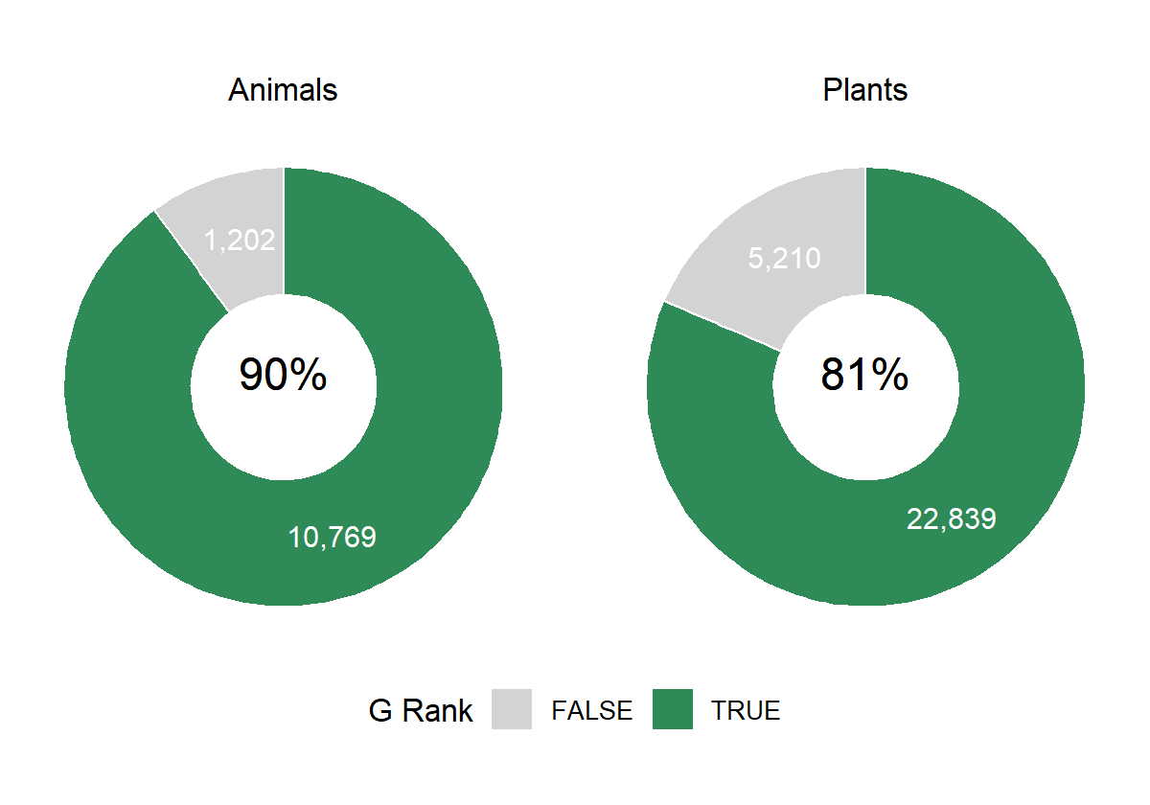
1. A global conservation status assessment.
Figure 1 . Percent of plants and animals in the primary global dataset with a global conservation status (G-rank or T-rank other than GNR/TNR).

Slide 5
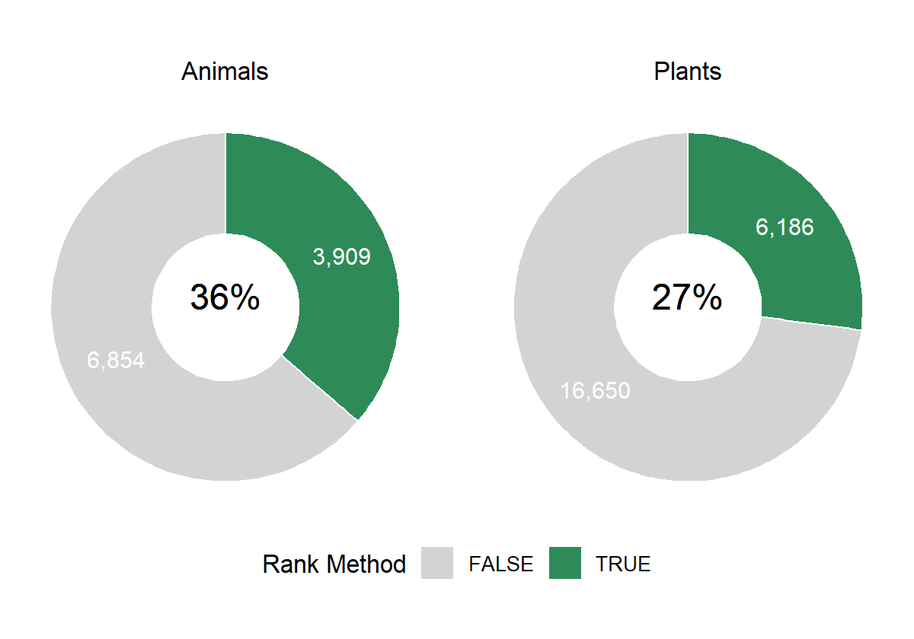
2. Documentation of the ranking methodology.
Figure 2 . Percent of elements with rank methodology recorded. Center values show the percent of elements with rank methodology recorded (True, shown in green). White values indicate the number of elements for which the standard is true or false.

Slide 6
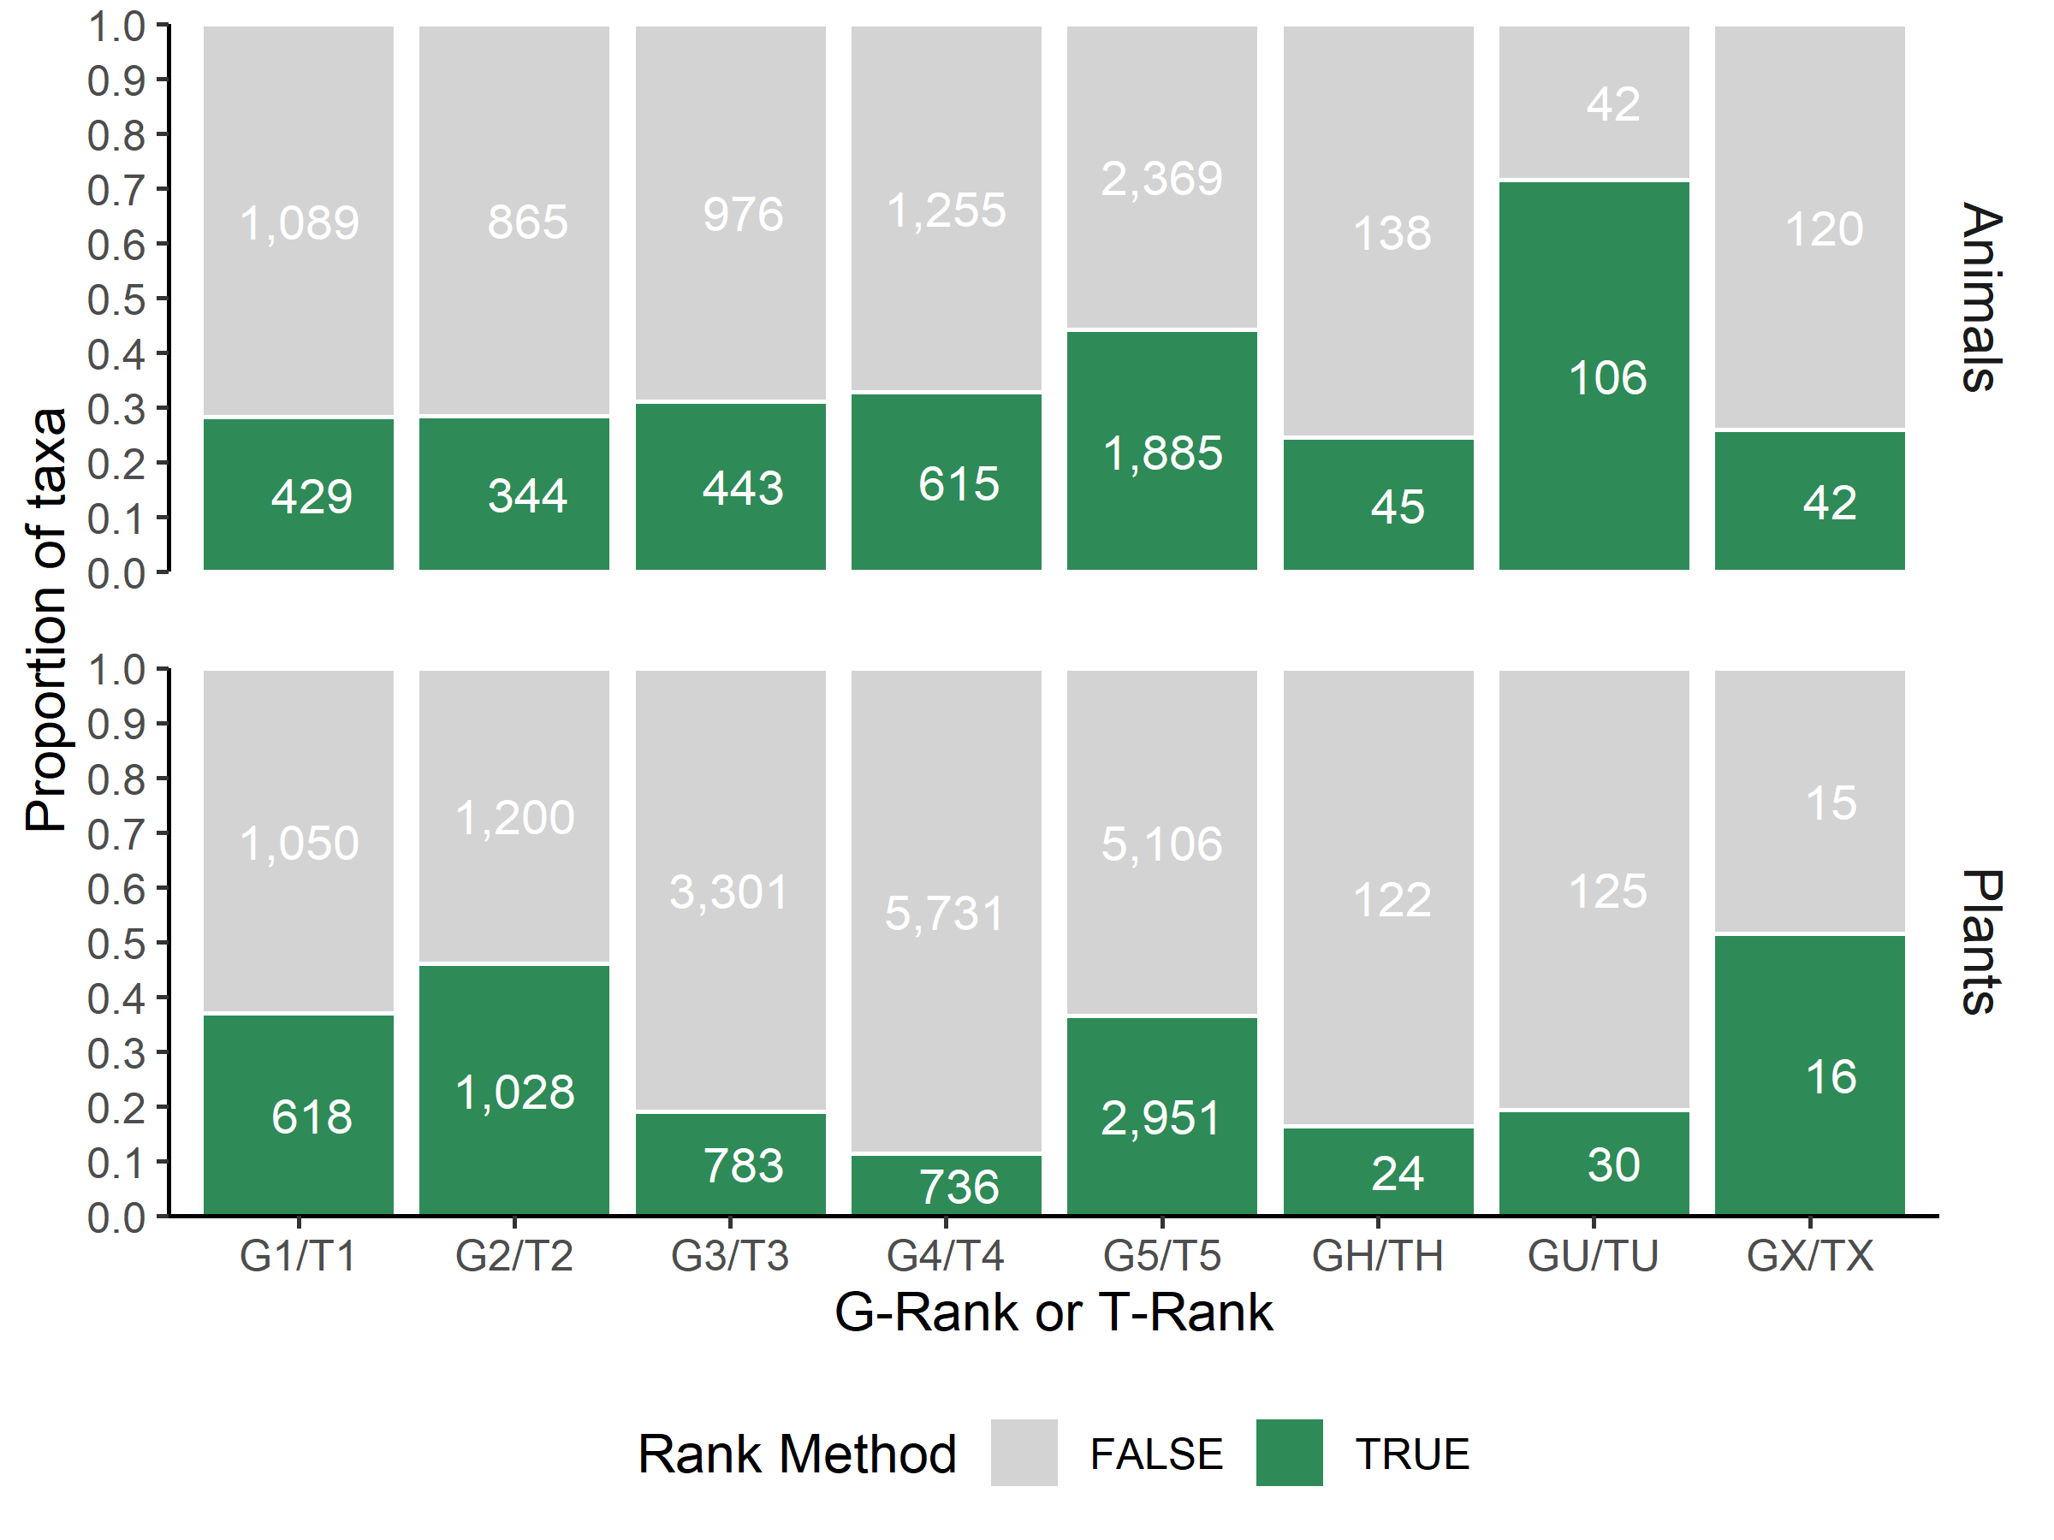
Figure 3 . Proportion of elements with rank methodology recorded by G-rank/T-rank. White values indicate the number of elements for which the standard is true (i.e. rank methodology is recorded, shown in green) or false (i.e., rank methodology is not recorded, shown in grey).

Slide 7
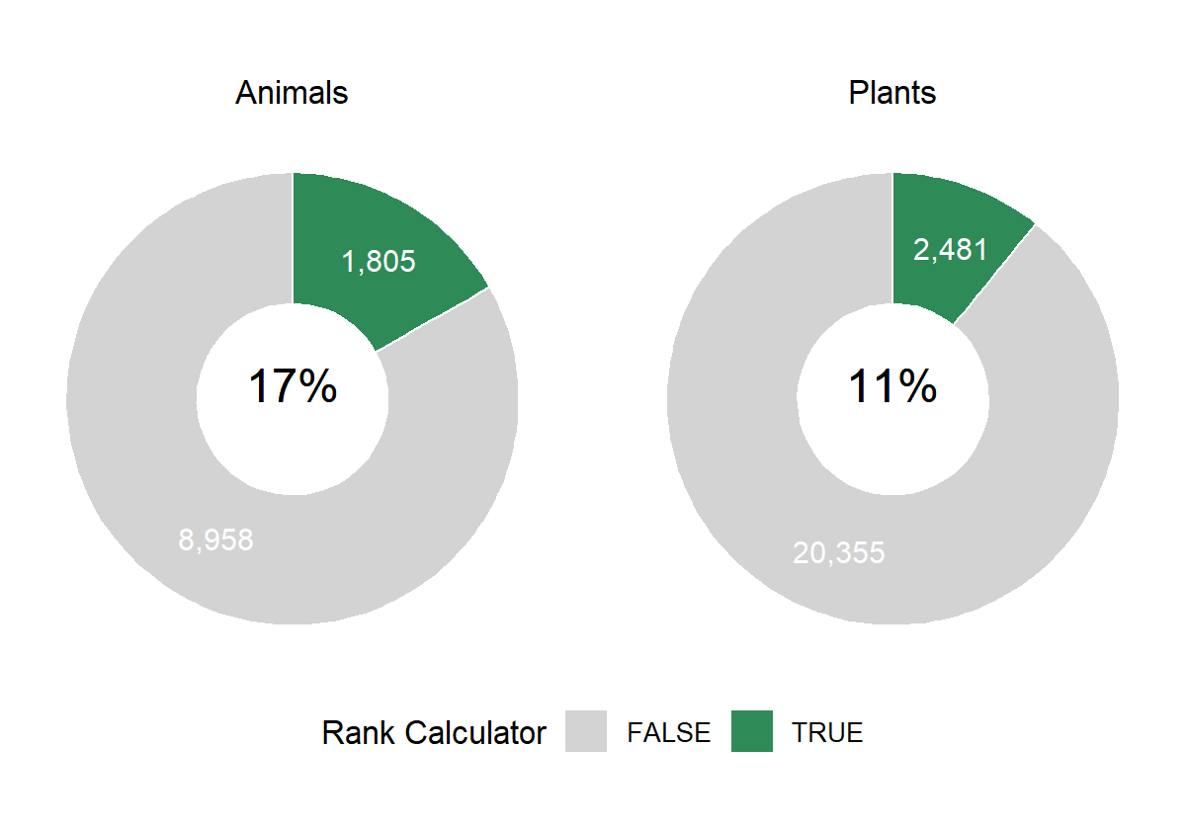
Figure 4 . Percent of elements that use the rank calculator. Center values show the percent of elements that were ranked using the rank calculator (True, shown in green). White values indicate the number of elements for which the standard is true or false.

Slide 8
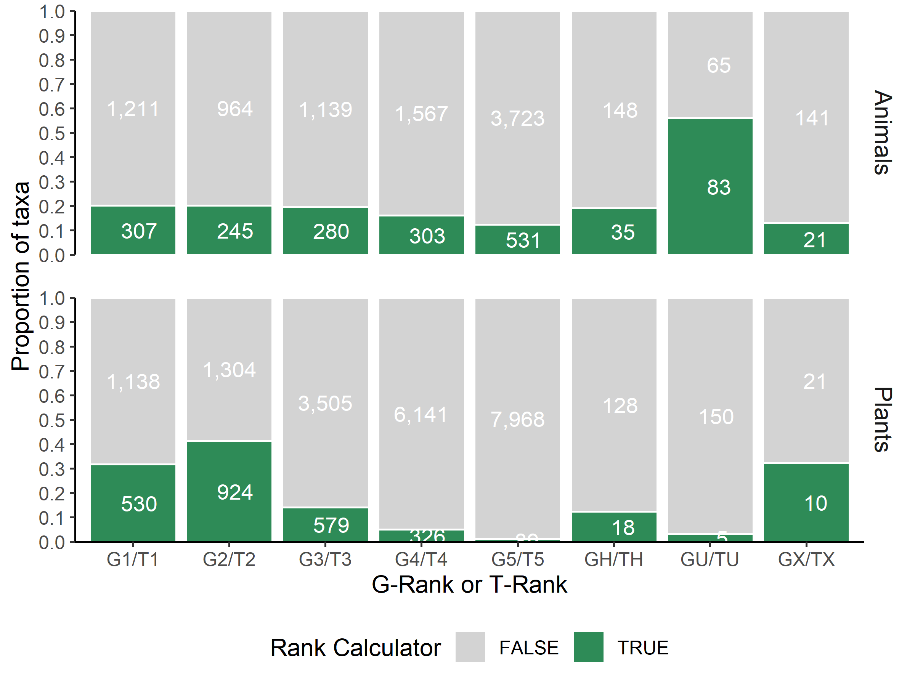
Figure 5 . Proportion of elements that were ranked using the rank calculator by G-rank. White values indicate the number of elements for which the standard is true (i.e. the rank calculator was used, shown in green) or false (i.e., the rank calculator was not used, shown in grey).

Slide 9
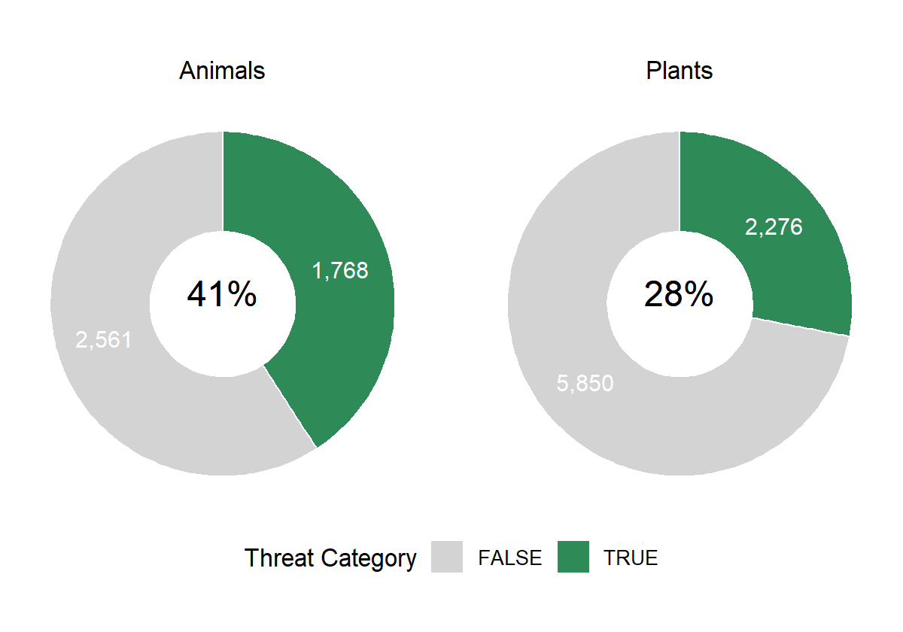
3. Threat categories indicated for at-risk elements, even if “unknown”.
Figure 6 . Percent of at-risk elements with at least one threat category marked. Center values show the percent of at-risk elements (elements that are ranked GH/G1/G2/G3 or TH/T1/T2/T3) that have at least one threat category marked (True, shown in green). White values indicate the number of elements for which the standard is true or false.

Slide 10
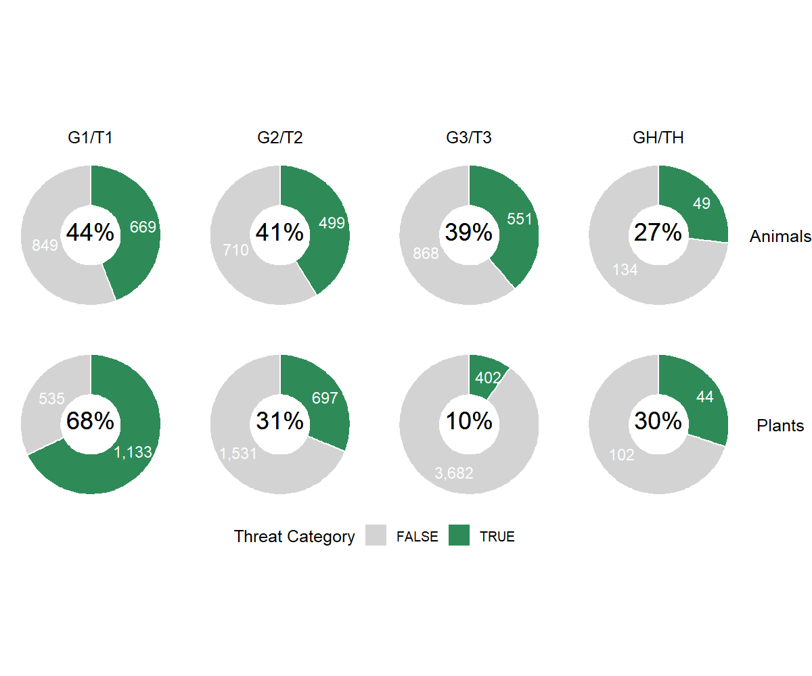
Figure 7 . Percent of at-risk elements with at least one threat category marked by G-rank. White values indicate the number of elements for which the standard is true (i.e. at least one threat category is marked, shown in green) or false (i.e., no threat categories are marked, shown in grey).

Slide 11
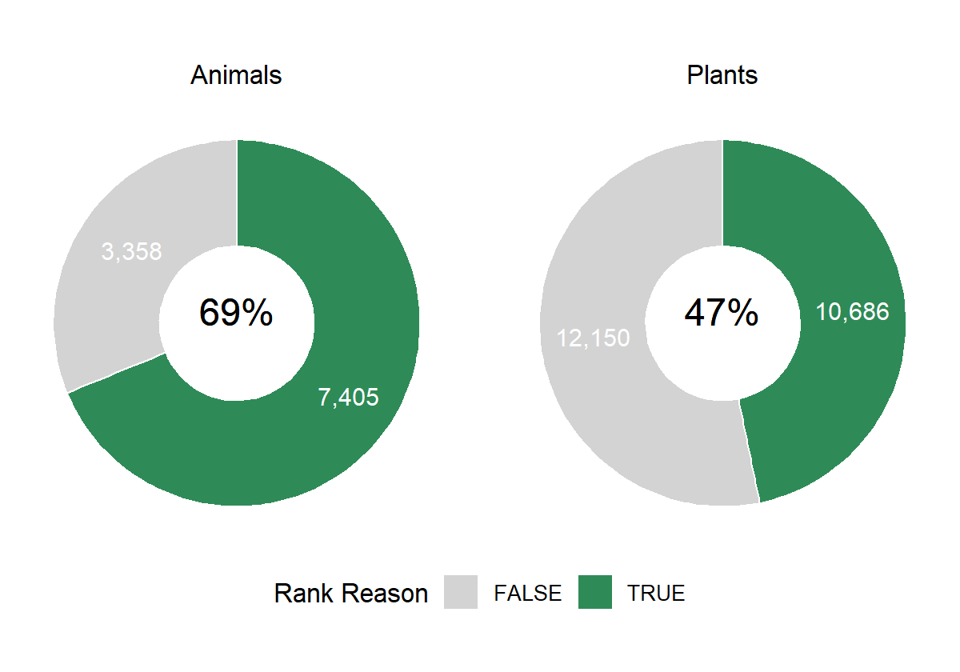
4. A rank reasons statement.
Figure 8 . Percent of elements with a rank reasons statement.

Slide 12
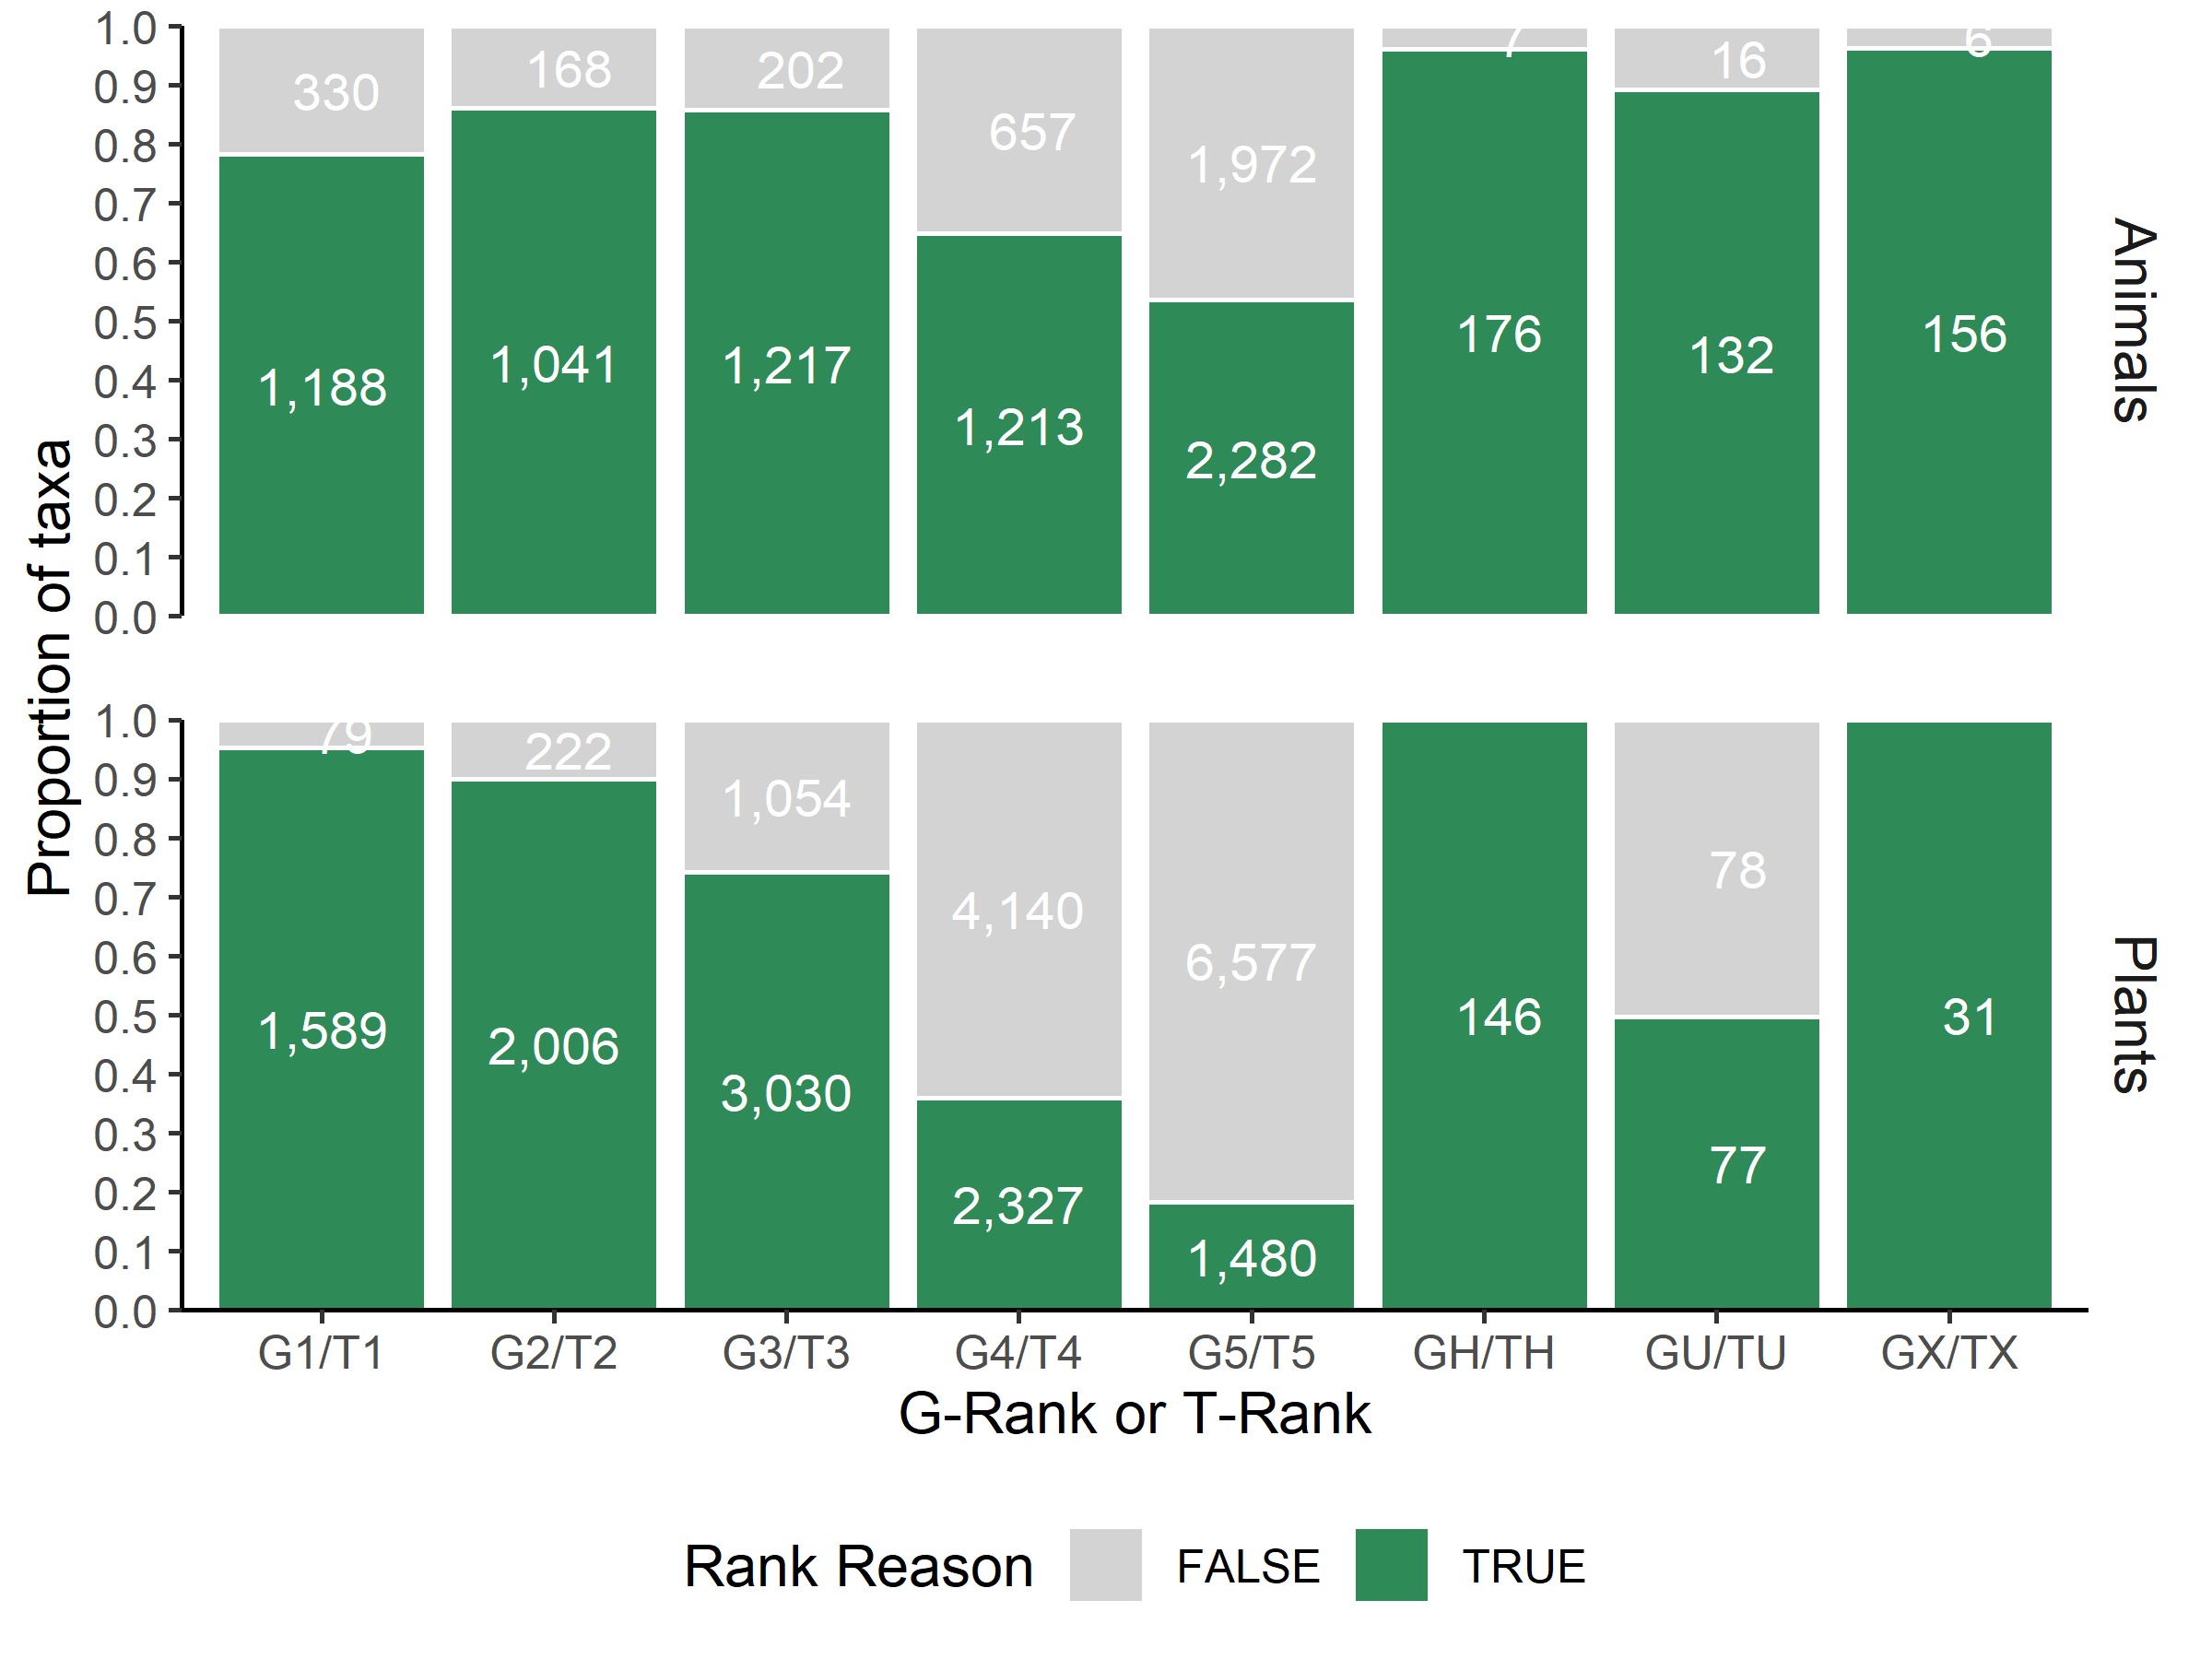
Figure 9 . Percent of elements of each G-rank with a rank reasons statement. White values indicate the number of elements for which the standard is true (i.e. a rank reasons statement is given, shown in green) or false (i.e., no rank reasons statement is given, shown in grey).

Slide 13
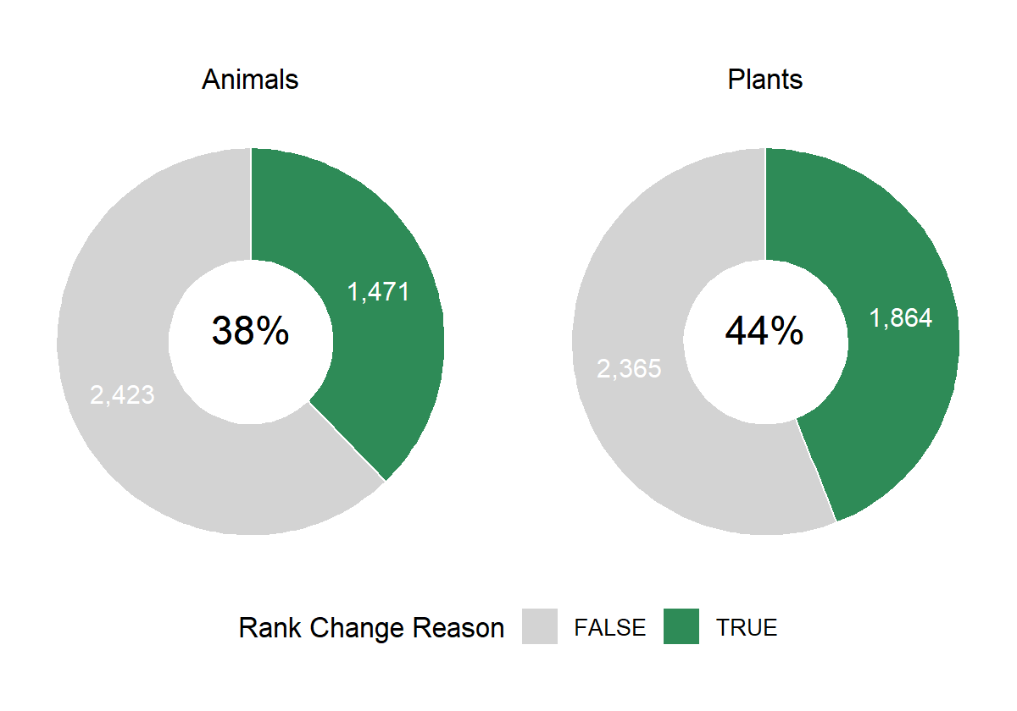
5. Indication of the reason for most recent rank change.
Figure 10 . Percent of elements with the reasons for rank change indicated. Only elements that have had a rank change are included. The date of the rank change must be the same as the date of the rank reasons statement for this standard to be evaluated as true.

Slide 14
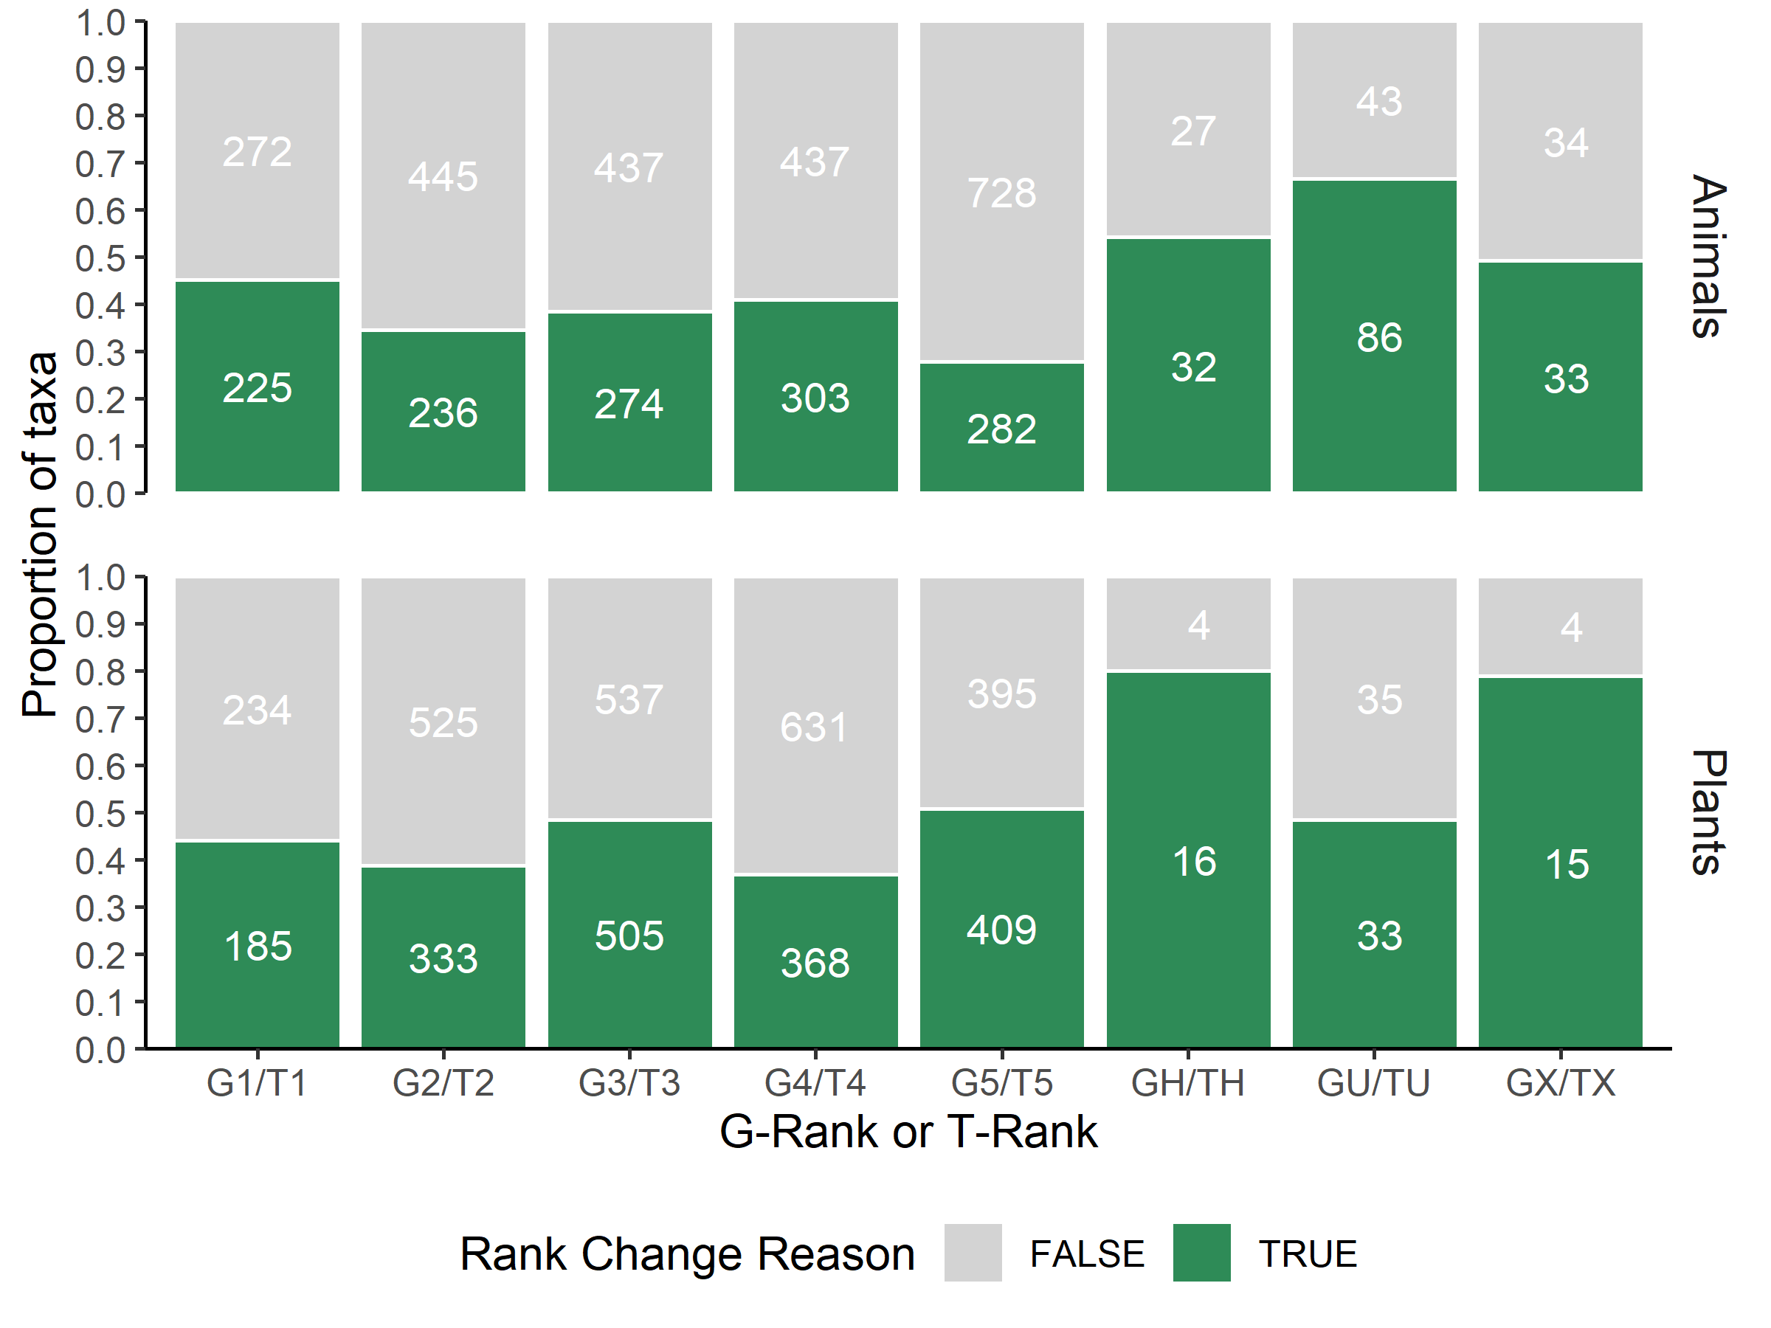
Figure 11 . Proportion of elements of each G-rank with rank change reasons indicated.

Slide 15
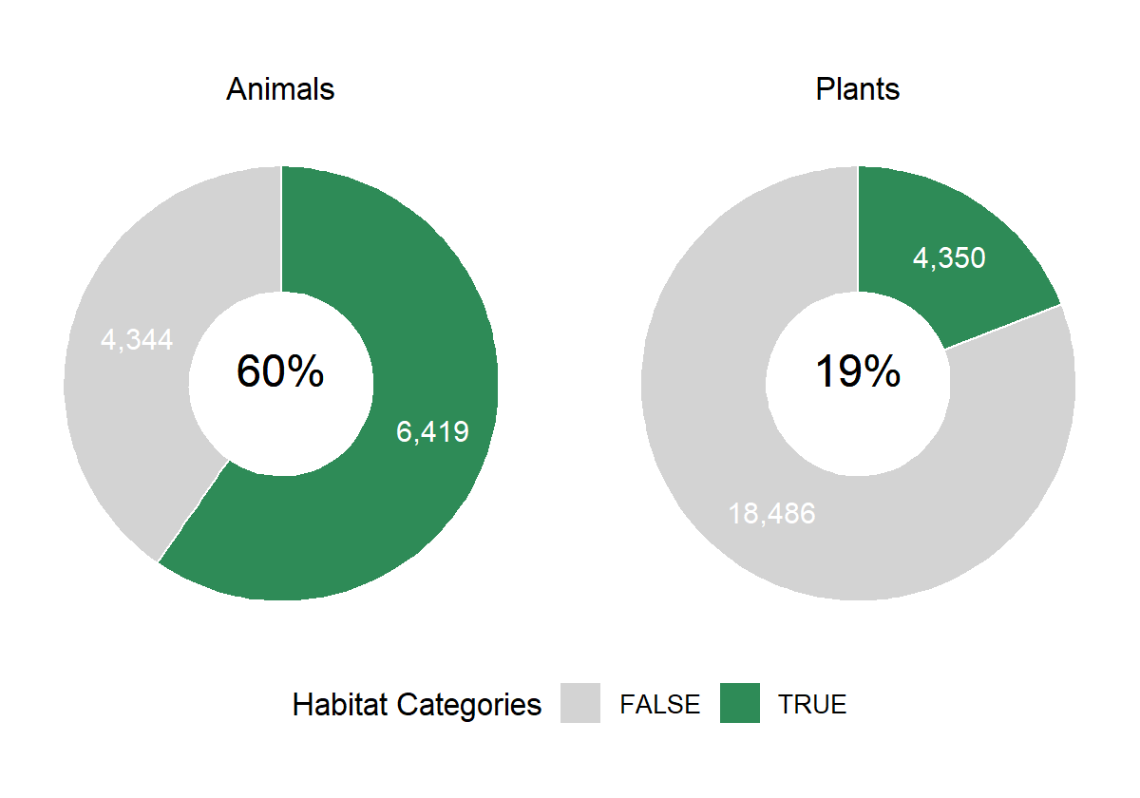
6. Habitat categories indicated.
Figure 12 . Percent of elements with at least one habitat cateogry selected.

Slide 16
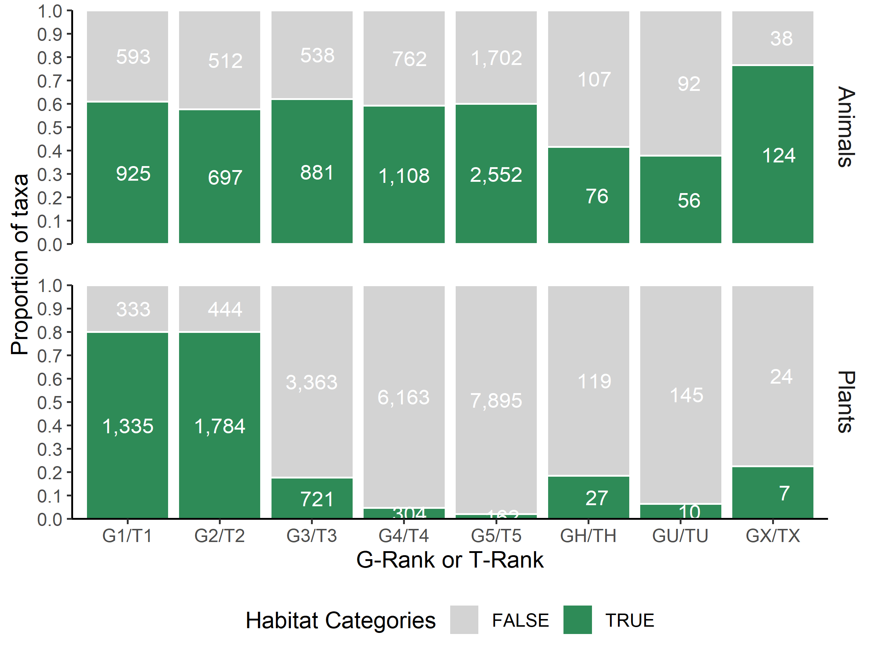
Figure 13 . Proportion of elements with at least one habitat category selected by G-rank.

Slide 17
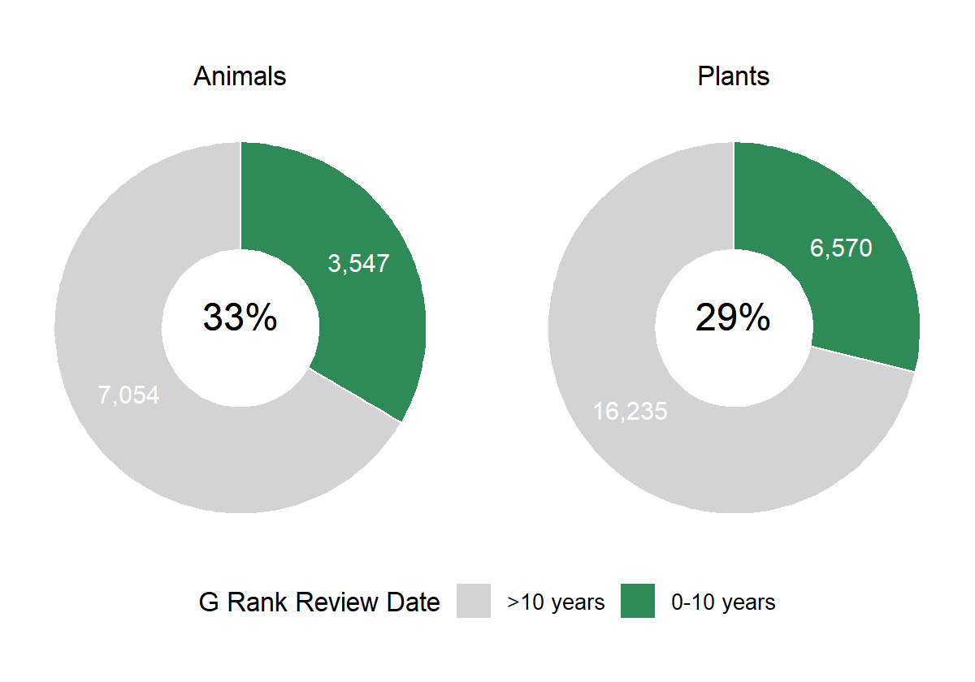
7. A review of the global status rank at least every 10 years.
Figure 14 . Percent of elements with a global rank that was reviewed within the last ten years. Elements with conservation status ranks of GNA/TNA, GNR/TNR, and GX/TX are excluded.

Slide 18
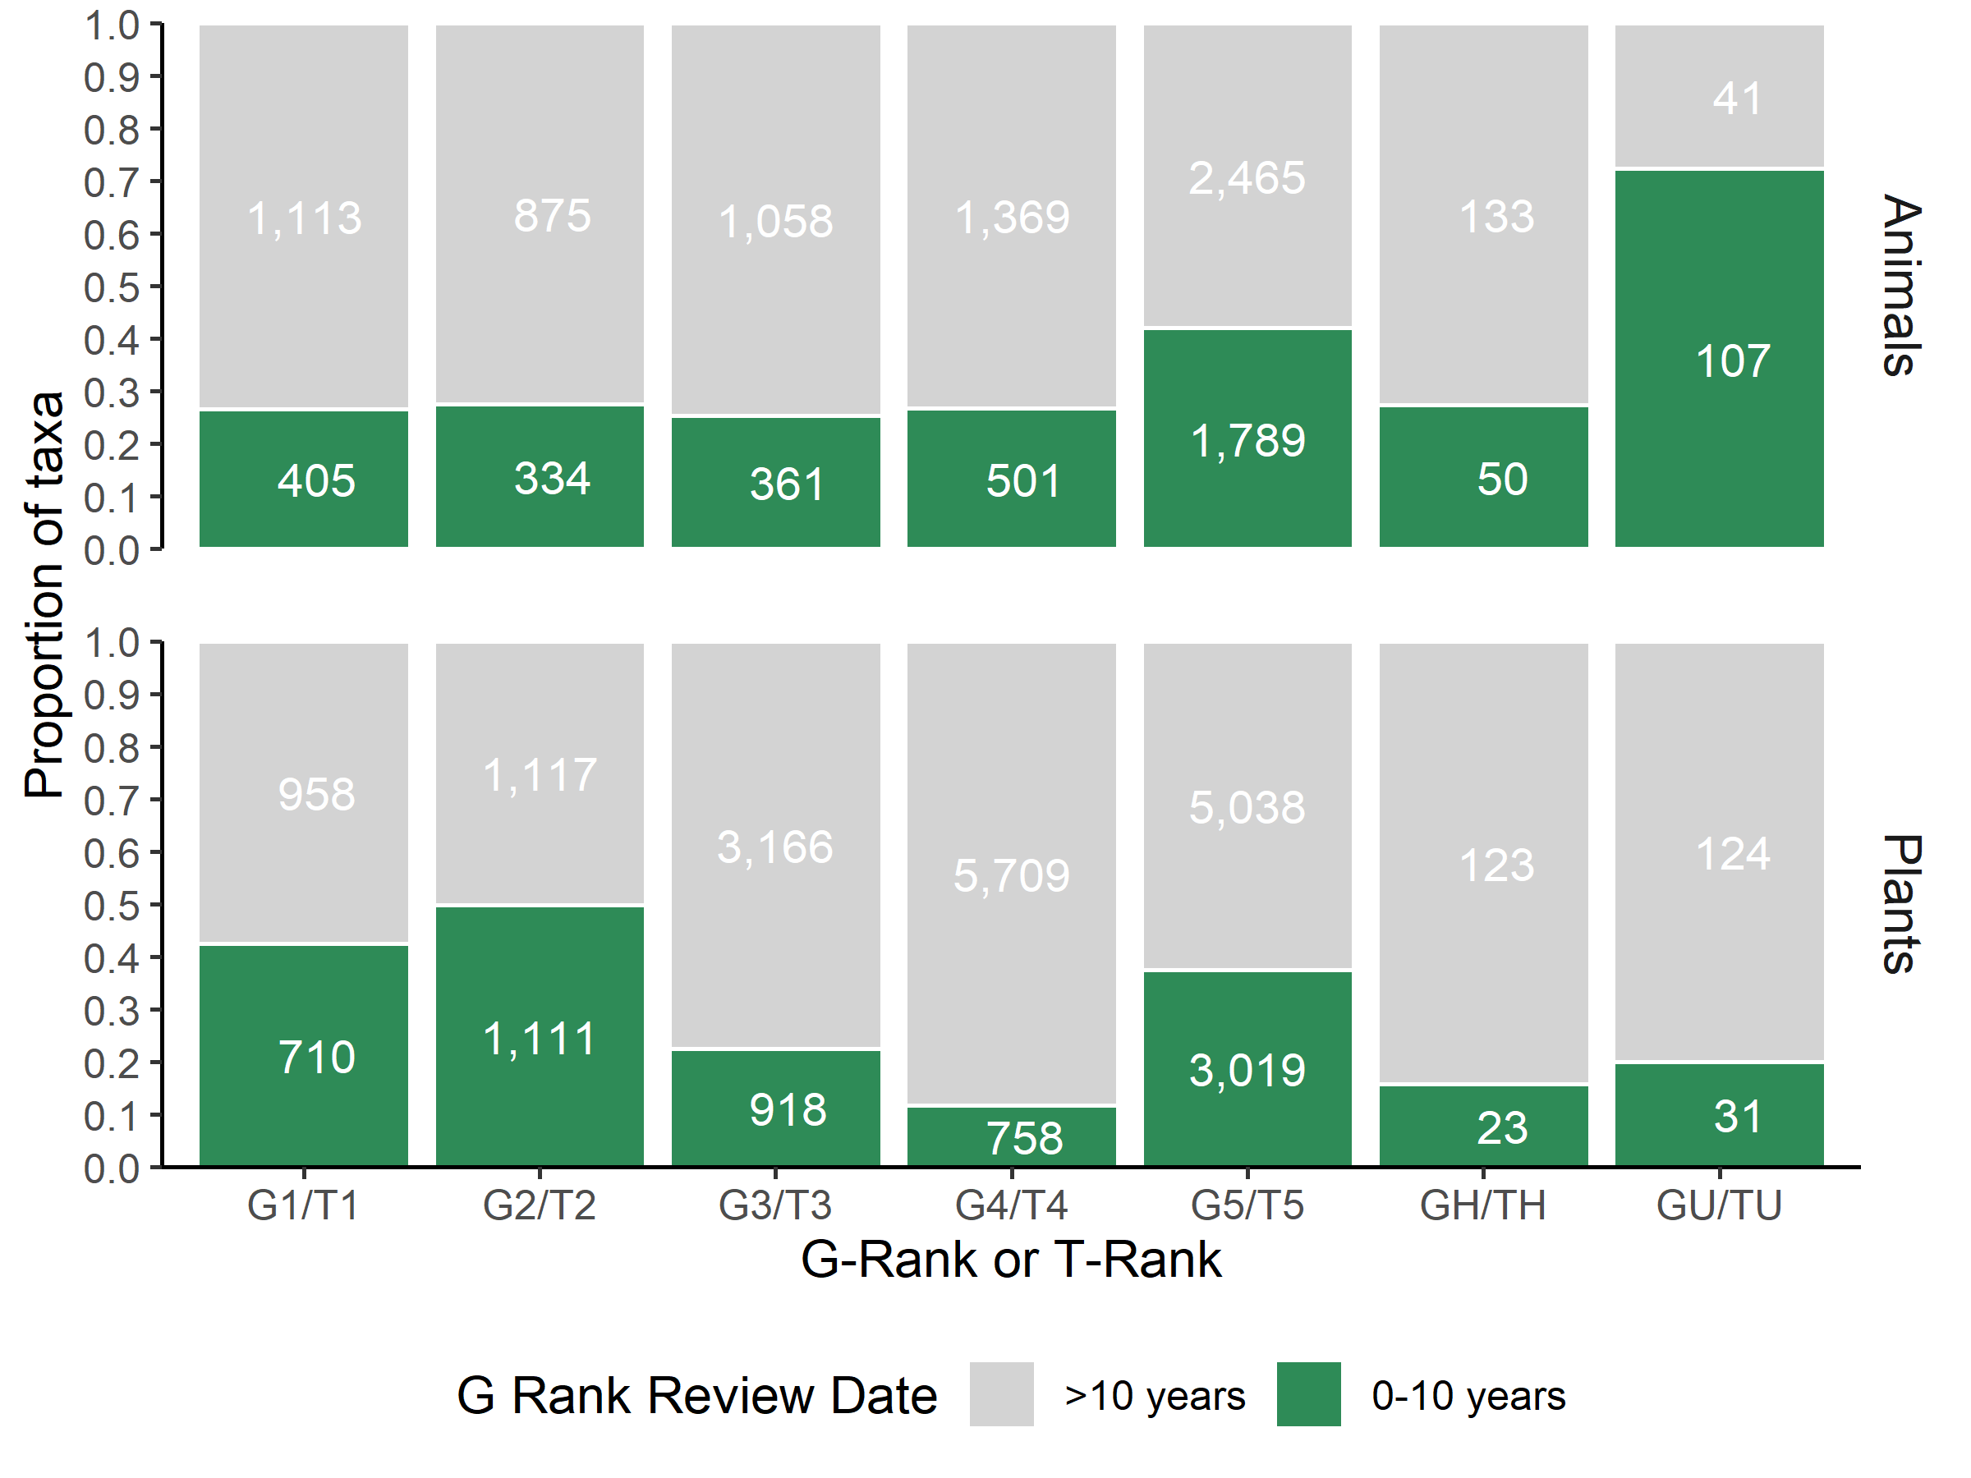
Figure 15 . Proportion of elements with a global rank that was reviewed within the last 10 years by G-rank. Elements with conservation status ranks of GNA/TNA, GNR/TNR, and GX/TX are excluded.

Slide 19
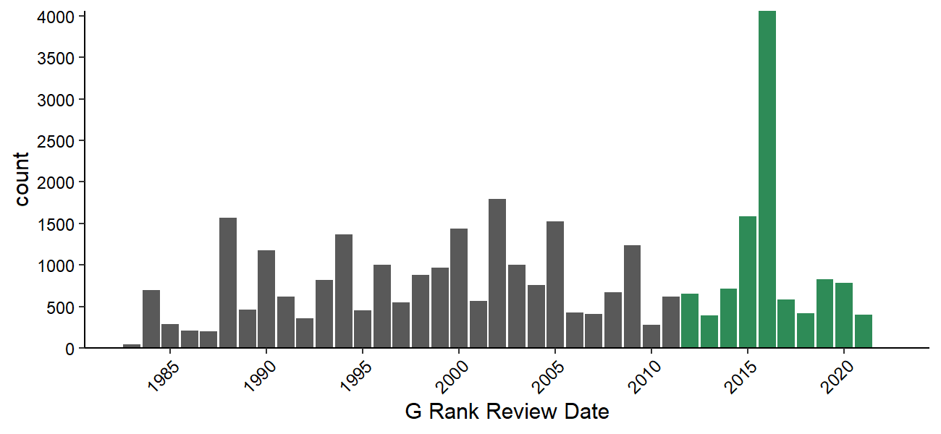
Figure 16 . Histogram of the year of last global rank review. Elements with a global rank review within the last ten years appear in green. Elements with conservation status ranks of GNA/TNA, GNR/TNR, and GX/TX are excluded.

Slide 20
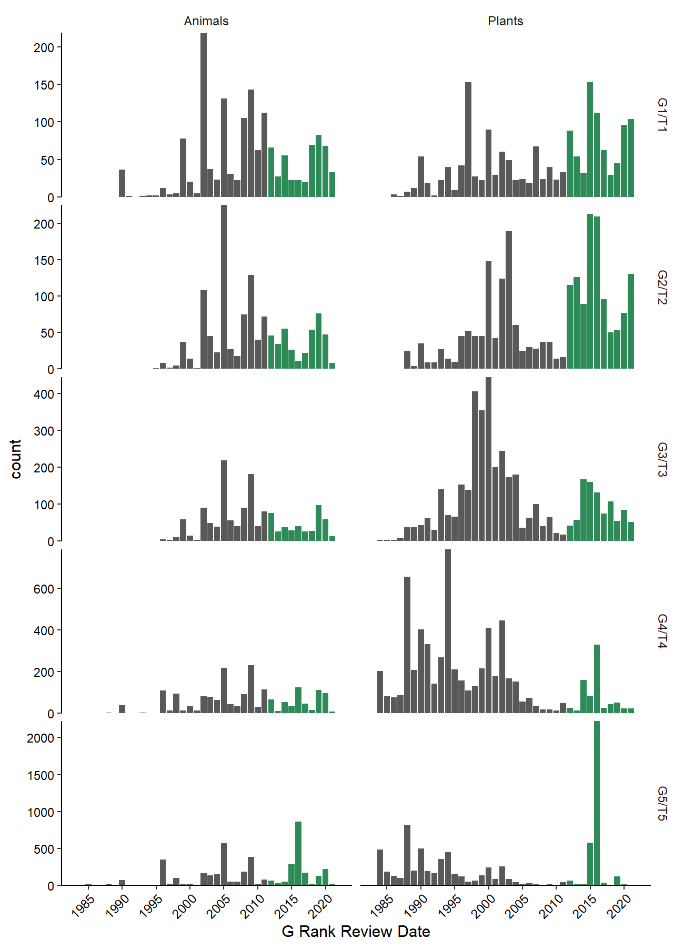
Figure 17 . Histogram of the year of last global rank review by G-rank. Elements with a global rank review within the last ten years appear in green. Elements with conservation status ranks of GNA/TNA, and GX/TX are excluded.

